Slide 1
Indian Catastrophe Risk Modeling
By Gopalakrishnan Kumar, MTech IIT-Bombay,
Freelance Data Science Consultant
LinkedIn: Profile Link : https://www.linkedin.com/in/gopalakrishnankumar-a73301110/
Github:https://www.github.com/Gopalakrishnan-Kumar/
Kaggle URL- https://www.kaggle.com/gopalkk2

Slide 2
Google Colab URL
https://colab.research.google.com/drive/1q6G07QyfpVHRrOVdy9OqU6G5NJRJ8n4T?usp=sharing

Slide 3
Executive Summary
The Indian Catastrophe Risk Modeling framework is designed to quantify, classify, and manage exposure arising from natural disasters such as floods, cyclones, and earthquakes across high-risk Indian states. This project applies risk scoring methodologies, exposure normalization techniques, and peril-based segmentation to support underwriting optimization, capital allocation, and reinsurance strategy decisions.
The model integrates:
Event Frequency
Severity Factor
Insured Exposure Value
Composite Catastrophe Risk Score
Risk Category Classification (Low / Medium / High)
The output enables actuarial, underwriting, and risk management teams to proactively manage catastrophe concentration and portfolio vulnerability.

Slide 4
Business Problem Statement
Indian insurers face increasing catastrophe exposure due to:
Climate volatility
Urban expansion
High coastal concentration
Increasing insured asset values
Traditional underwriting lacks structured catastrophe scoring frameworks, leading to:
Underpriced high-risk policies
Capital strain during extreme events
Inadequate reinsurance structuring
Regional concentration risk
This project introduces a quantitative catastrophe risk scoring engine to improve underwriting precision and capital resilience.

Slide 5
Data Modeling Framework
The dataset includes:
State (Geographic concentration)
Peril Type (Flood / Cyclone / Earthquake)
Insured Value (Exposure amount)
Event Frequency (Historical disaster occurrence)
Severity Factor (Loss intensity coefficient)

Slide 6
Risk Score Engineering
Policies are classified into:
Low Risk (0 – 0.4)
Medium Risk (0.4 – 0.7)
High Risk (0.7 – 1.0)
This structured segmentation supports:
Risk-based pricing
Underwriting escalation triggers
Portfolio diversification control

Slide 7
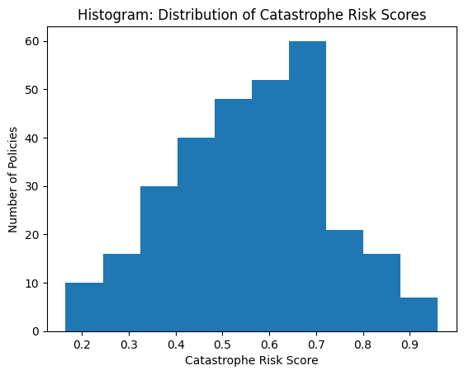
Data Visualization

Slide 8
Visualization & Analytical Insights
Histogram – Risk Distribution
The histogram reveals clustering in medium-risk bands, indicating moderate catastrophe exposure across most policies. High-risk tails identify concentration pockets requiring capital buffers.

Slide 9
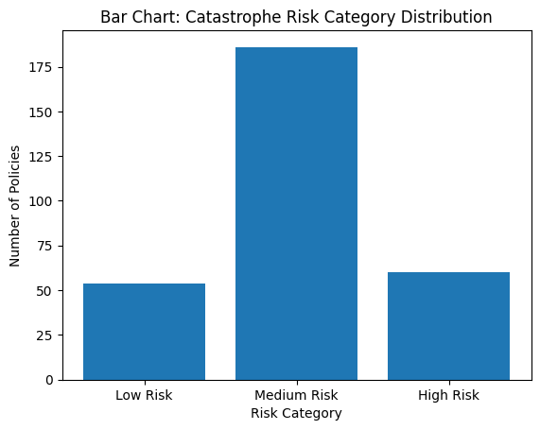
Data Visualization

Slide 10
Visualization & Analytical Insights
Bar Chart – Risk Category Distribution
This visualization highlights which peril contributes most to high-risk classification.
Example Insights:
Flood-driven risk may dominate eastern and coastal states.
Cyclone risk concentration suggests coastal underwriting tightening.
Earthquake exposure may cluster in seismic zones.

Slide 11
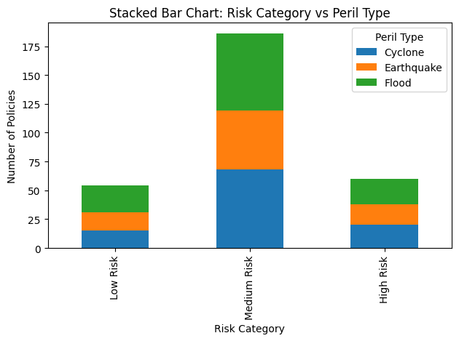
Data Visualization

Slide 12
Visualization & Analytical Insights
Stacked Bar Chart – Risk vs Peril Type
This visualization highlights which peril contributes most to high-risk classification.
Example Insights:
Flood-driven risk may dominate eastern and coastal states.
Cyclone risk concentration suggests coastal underwriting tightening.
Earthquake exposure may cluster in seismic zones.

Slide 13
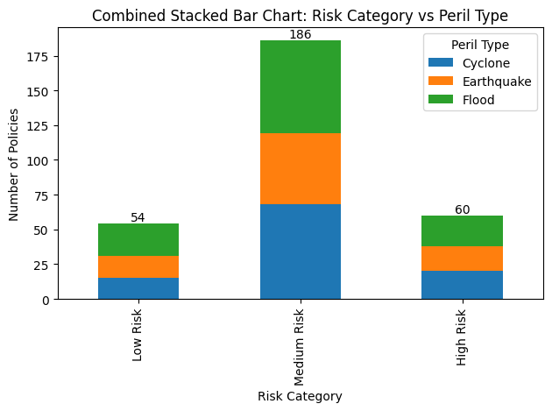
Data Visualization

Slide 14
Visualization & Analytical Insights
Combined Stacked Bar Chart – Executive View
This executive-level chart integrates:
Risk Category segmentation
Peril breakdown
Total exposure count per risk level
Strategic Value:
Identifies catastrophe-heavy underwriting segments
Supports reinsurance treaty negotiation
Enables capital stress testing
Provides board-level reporting clarity

Slide 15
State-Level Risk Interpretation
High-risk clustering in states such as:
Coastal zones (Cyclone exposure)
River basin regions (Flood exposure)
Seismic zones (Earthquake exposure)
This geographic concentration modeling allows:
State-wise premium adjustments
Regional underwriting caps
Targeted catastrophe modeling simulations

Slide 16
Strategic Business Impact
The catastrophe risk modeling system enables:
Risk-based premium differentiation
Underwriting automation triggers
Capital adequacy forecasting
Reinsurance structuring optimization
Portfolio diversification strategy
Loss ratio stabilization
Catastrophe reserve planning
Climate risk preparedness
Regulatory risk reporting support

Slide 17
Alignment with Zetheta Expectations
This project aligns with Zetheta's analytical standards through:
Quantitative risk engineering
Data-driven underwriting logic
Visual decision intelligence
Portfolio-level capital modeling
Scalable predictive architecture
The framework can be extended into:
Monte Carlo catastrophe simulation
ML-based loss severity prediction
Climate scenario modeling
Reinsurance optimization engine

Slide 18
Future Enhancements
Future Enhancements
To further strengthen the model:
Integrate real IMD disaster datasets
Add district-level geospatial risk mapping
Deploy machine learning severity predictors
Build an executive Power BI catastrophe dashboard
Implement stress-testing under extreme event simulations

Slide 19
Conclusion
The Indian Catastrophe Risk Modeling framework transforms traditional underwriting into a structured, risk-weighted, data-driven catastrophe management system.
By combining frequency, severity, and exposure scoring with business-grade visual analytics, insurers can:
Improve underwriting precision
Reduce unexpected loss volatility
Optimize reinsurance coverage
Enhance capital resilience
Strengthen regulatory compliance
This model provides a scalable foundation for enterprise-level catastrophe risk intelligence and strategic underwriting transformation.

Slide 20
Conclusion
This model provides a scalable foundation for enterprise-level catastrophe risk intelligence and strategic underwriting transformation.

